Slide 1

Data Communication CSE 315
Dr. A.K.M. Muzahidul Islam
Professor
Computer Science & Engineering (CSE)
United International University (UIU)
Fall 2018

Slide 2
Assessment
Attendance : 5%
Assignments : 5%
Class Tests : 20%
Mid Term : 30%
Final : 40%
Grading Policy
A (Plain) : 90-100 C+ (Plus) : 70-73
A- (Minus) : 86-89 C (Plain) : 66-69
B+ (Plus) : 82-85 C- (Minus) : 62-65
B (Plain) : 78-81 D+ (Plus) : 58-61
B- (Minus) : 74-77 D (Plain) : 55-57

Slide 3
Resources
Data Communications and Networking. Behrouz A. Forouzan “Chapter 3”

Slide 4
Outline
Byte Stuffing
Bit Stuffing

Slide 5
DATA RATE LIMITS
A very important consideration in data communications is how fast we can send data, in bits per second, over a channel. Data rate depends on three factors:
1. The bandwidth available
2. The level of the signals we use
3. The quality of the channel (the level of noise)
Topics:
Noiseless Channel: Nyquist Bit Rate
Noisy Channel: Shannon Capacity
Using Both Limits

Slide 6
Capacity of a System
The bit rate of a system increases with an increase in the number of signal levels we use to denote a symbol.
A symbol can consist of a single bit or “n” bits.
The number of signal levels = 2^{n}.
As the number of levels goes up, the spacing between level decreases -> increasing the probability of an error occurring in the presence of transmission impairments.

Slide 7
Nyquist Bandwidth
In the case of a channel that is noise free:
The limitation of data rate is simply the bandwidth of the signal
If the rate of signal transmission is 2B then a signal with frequencies no greater than B is sufficient to carry the signal rate
Given a bandwidth of B, the highest signal rate that can be carried is 2B
For binary signals, the data rate that can be supported by B Hz is 2B bps
With multilevel signaling, the Nyquist formula becomes: C = 2B log₂M
Data rate can be increased by increasing the number of different signal elements
This increases burden on receiver
Noise and other impairments limit the practical value of M
Notes:
To begin, let us consider the case of a channel that is noise free. In this environment, the limitation on data rate is simply the bandwidth of the signal. A formulation of this limitation, due to Nyquist, states that if the rate of signal transmission is 2B, then a signal with frequencies no greater than B is sufficient to carry the signal rate. The converse is also true: Given a bandwidth of B, the highest signal rate that can be carried is 2B. This limitation is due to the effect of intersymbol interference, such as is produced by delay distortion. The result is useful in the development of digital-to-analog encoding schemes and is, in essence, based on the same derivation as that of the sampling theorem, described in Appendix G.
Note that in the preceding paragraph, we referred to signal rate. If the signals to be transmitted are binary (two voltage levels), then the data rate that can be supported by B Hz is 2B bps. However, as we shall see in Chapter 5, signals with more than two levels can be used; that is, each signal element can represent more than one bit. For example, if four possible voltage levels are used as signals, then each signal element can represent two bits. With multilevel signaling, the Nyquist formulation becomes
C = 2B log₂M
where M is the number of discrete signal or voltage levels.
So, for a given bandwidth, the data rate can be increased by increasing the number of different signal elements. However, this places an increased burden on the receiver: Instead of distinguishing one of two possible signal elements during each signal time, it must distinguish one of M possible signal elements. Noise and other impairments on the transmission line will limit the practical value of M.

Slide 8
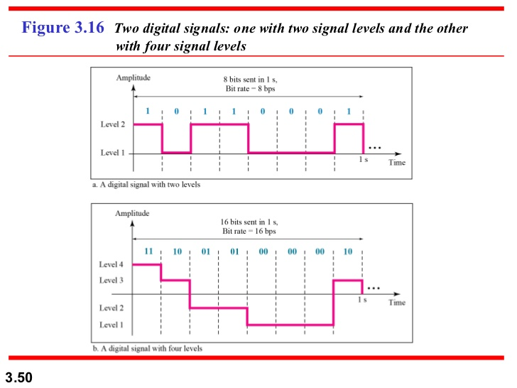
Increasing the levels of a signal increases the probability of an error occurring.
In other words, it reduces the reliability of the system.

Slide 9
Nyquist Theorem
Nyquist gives the upper bound for the bit rate of a transmission system by calculating the bit rate directly from the number of bits in a symbol (or signal levels) and the bandwidth of the system (assuming 2 symbols/per cycle).
Nyquist theorem states that for a noiseless channel:
C = 2 B log₂2^{n}
C= capacity in bps
B = bandwidth in Hz

Slide 10
Example 1
Consider a noiseless channel with a bandwidth of 3000 Hz transmitting a signal with two signal levels. The maximum bit rate can be calculated as

Slide 11
Example 2
Consider the same noiseless channel transmitting a signal with four signal levels (for each level, we send 2 bits). The maximum bit rate can be calculated as

Slide 12
Example 3
We need to send 265 kbps over a noiseless channel with a bandwidth of 20 kHz. How many signal levels do we need?
Solution
We can use the Nyquist formula as shown:
Since this result is not a power of 2, we need to either increase the number of levels or reduce the bit rate. If we have 128 levels, the bit rate is 280 kbps. If we have 64 levels, the bit rate is 240 kbps.

Slide 13
Shannon Capacity Formula
Considering the relation of data rate, noise and error rate:
Faster data rate shortens each bit so bursts of noise corrupts more bits
Given noise level, higher rates mean higher errors
Shannon developed formula relating these to signal to noise ratio (in decibels)
SNR_{db}⁼10 log₁₀ (signal/noise)
Capacity C = B log₂(1+SNR)
Theoretical maximumcapacity
Get much lower rates in practice
Notes:
Nyquist's formula indicates that, all other things being equal, doubling the bandwidth doubles the data rate. Now consider the relationship among data rate, noise, and error rate. The presence of noise can corrupt one or more bits. If the data rate is increased, then the bits become "shorter" so that more bits are affected by a given pattern of noise.
Figure 3.15 illustrates this relationship. If the data rate is increased, then more bits will occur during the interval of a noise spike, and hence more errors will occur.
All of these concepts can be tied together neatly in a formula developed by the mathematician Claude Shannon. As we have just illustrated, the higher the data rate, the more damage that unwanted noise can do. For a given level of noise, we would expect that a greater signal strength would improve the ability to receive data correctly in the presence of noise. The key parameter involved in this reasoning is the signal-to-noise ratio (SNR, or S/N), which is the ratio of the power in a signal to the power contained in the noise that is present at a particular point in the transmission. Typically, this ratio is measured at a receiver, because it is at this point that an attempt is made to process the signal and recover the data. For convenience, this ratio is often reported in decibels:
The signal-to-noise ratio is important in the transmission of digital data because it sets the upper bound on the achievable data rate. Shannon's result is that the maximum channel capacity, in bits per second, obeys the equation
C = B log2 (1 + SNR) (3.1)
where C is the capacity of the channel in bits per second and B is the bandwidth of the channel in hertz. The Shannon formula represents the theoretical maximum that can be achieved. In practice, however, only much lower rates are achieved. One reason for this is that the formula assumes white noise (thermal noise). Impulse noise is not accounted for, nor are attenuation distortion or delay distortion. Even in an ideal white noise environment, present technology still cannot achieve Shannon capacity due to encoding issues, such as coding length and complexity.
The capacity indicated in the preceding equation is referred to as the error-free capacity. Shannon proved that if the actual information rate on a channel is less than the error-free capacity, then it is theoretically possible to use a suitable signal code to achieve error-free transmission through the channel. Shannon's theorem unfortunately does not suggest a means for finding such codes, but it does provide a yardstick by which the performance of practical communication schemes may be measured.
Several other observations concerning the preceding equation may be instructive. For a given level of noise, it would appear that the data rate could be increased by increasing either signal strength or bandwidth. However, as the signal strength increases, so do the effects of nonlinearities in the system, leading to an increase in intermodulation noise. Note also that, because noise is assumed to be white, the wider the bandwidth, the more noise is admitted to the system. Thus, as B increases, SNR decreases.
The Expression Eb/N0
Finally, we mention a parameter related to SNR that is more convenient for determining digital data rates and error rates and that is the standard quality measure for digital communication system performance. The parameter is the ratio of signal energy per bit to noise power density per hertz, Eb/N0. Consider a signal, digital or analog, that contains binary digital data transmitted at a certain bit rate R. Recalling that 1 watt = 1 J/s, the energy per bit in a signal is given by Eb = STb, where S is the signal power and Tb is the time required to send one bit. The data rate R is just R = 1/Tb.
The ratio Eb/N0 is important because the bit error rate for digital data is a (decreasing) function of this ratio. Given a value of Eb/N0 needed to achieve a desired error rate, the parameters in the preceding formula may be selected. Note that as the bit rate R increases, the transmitted signal power, relative to noise, must increase to maintain the required Eb/N0.
Let us try to grasp this result intuitively by considering again Figure 3.15. The signal here is digital, but the reasoning would be the same for an analog signal. In several instances, the noise is sufficient to alter the value of a bit. If the data rate were doubled, the bits would be more tightly packed together, and the same passage of noise might destroy two bits. Thus, for constant signal to noise ratio, an increase in data rate increases the error rate.
The advantage of Eb/N0 over SNR is that the latter quantity depends on the bandwidth.

Slide 14
Shannon’s Theorem
Shannon’s theorem gives the capacity of a system in the presence of noise.
C = B log₂(1 + SNR)

Slide 15
Example 4
Consider an extremely noisy channel in which the value of the signal-to-noise ratio is almost zero. In other words, the noise is so strong that the signal is faint. For this channel the capacity C is calculated as
This means that the capacity of this channel is zero regardless of the bandwidth. In other words, we cannot receive any data through this channel.

Slide 16
Example 5
We can calculate the theoretical highest bit rate of a regular telephone line. A telephone line normally has a bandwidth of 3000. The signal-to-noise ratio is usually 3162. For this channel the capacity is calculated as
This means that the highest bit rate for a telephone line is 34.860 kbps. If we want to send data faster than this, we can either increase the bandwidth of the line or improve the signal-to-noise ratio.

Slide 17
Example 6
The signal-to-noise ratio is often given in decibels. Assume that SNR_{dB} = 36 and the channel bandwidth is 2 MHz. The theoretical channel capacity can be calculated as

Slide 18


Example 7
For practical purposes, when the SNR is very high, we can assume that SNR + 1 is almost the same as SNR. In these cases, the theoretical channel capacity can be simplified to
For example, we can calculate the theoretical capacity of the previous example as

Slide 19
Example 8
We have a channel with a 1-MHz bandwidth. The SNR for this channel is 63. What are the appropriate bit rate and signal level?
Solution
First, we use the Shannon formula to find the upper limit.

Slide 20
Example 8 (continued)
The Shannon formula gives us 6 Mbps, the upper limit. For better performance we choose something lower, 4 Mbps, for example. Then we use the Nyquist formula to find the number of signal levels.

Slide 21
The Shannon capacity gives us the upper limit;
the Nyquist formula tells us how many signal levels we need.

Slide 22


Slide 23
Thank You

